Slide 1
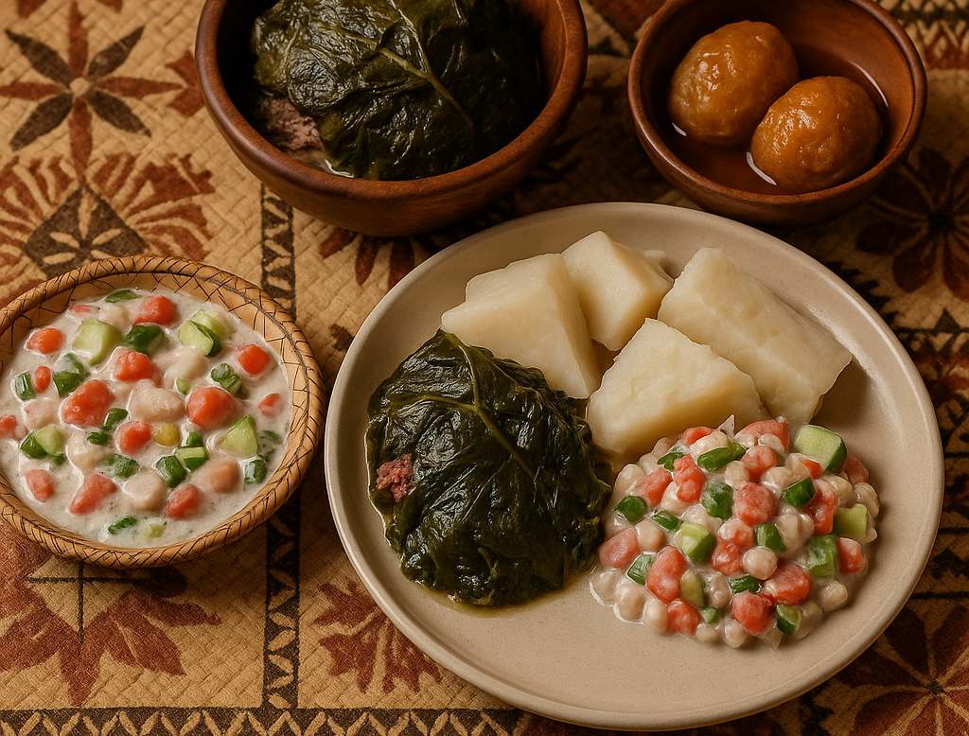
A Taste of Tonga: Pop-up Dining Experience
Experience Authentic traditional tongan food and culture
Shayde, and 'Aneti

Slide 2
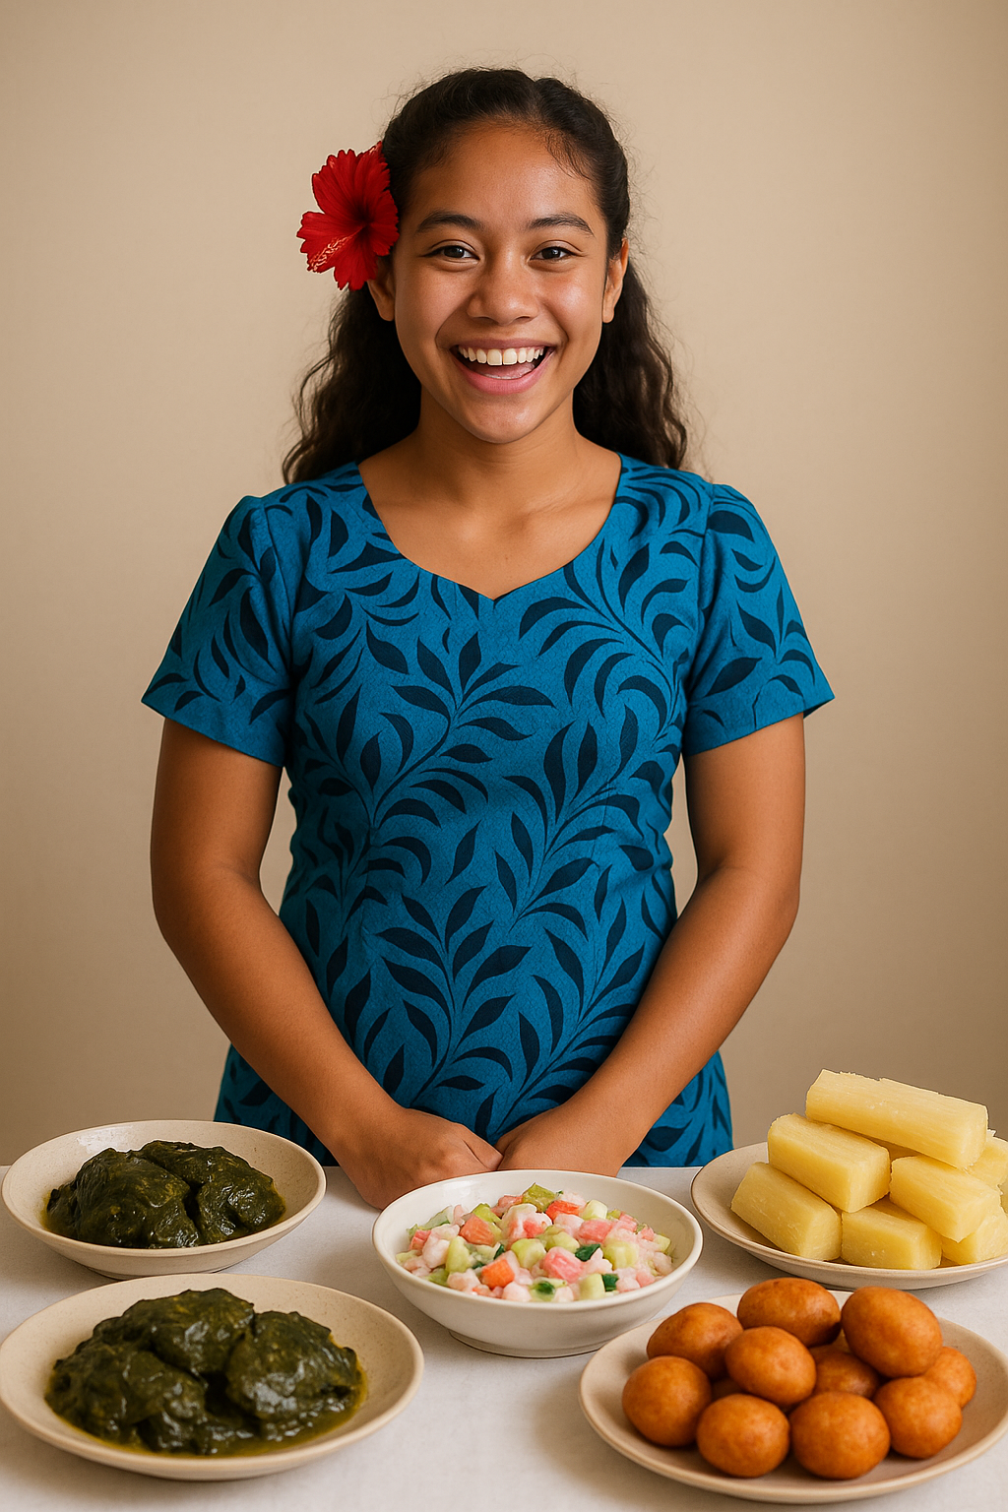
A Taste of Tonga:
A Taste of Tonga is our idea of bringing an exciting authentic Tongan experience to our customer's stomachs! As a pop-up dining event, in partnership with PCC, we are bringing a slice of the life in Tonga to the people! But only for a short special time. This experience is for all who want to further explore the islands of Tonga whether it be family, friends, or the local community!
What makes us unique:
For those who want, special VIP seats viewing exactly how their food is made + interactivity
The Tongan Humor: while your food is being made enjoy what our presiding Tongan says

Slide 3
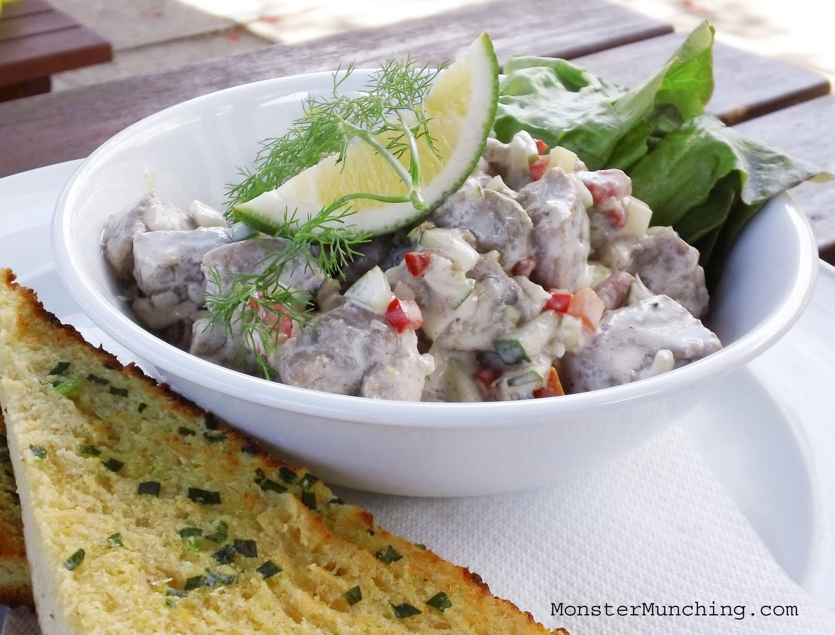
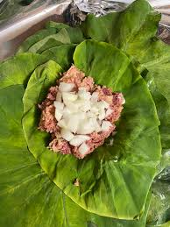
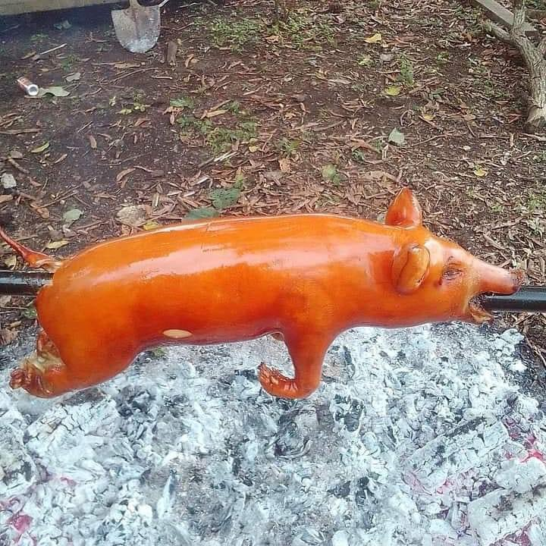
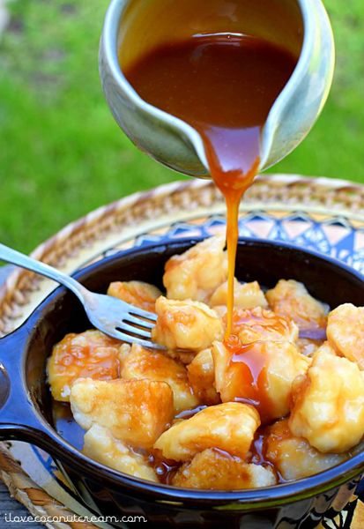
The Menu
'Ota Ika
Lu Pulu
Puaka Tunu​
Faikakai
raw fish marinated in citrus juice, typically lemon or lime, and coconut milk
Taro leaves, with beef meat, onion and coconut milk
Rosted pig
a Tongan dessert featuring soft dumplings in a sweet coconut syrup

Slide 4

Profitability
Cost Control
In order for us to keep our expenses low, we will utilize the community and source locally if possible. This way we are able to keep the quality and authenticity high.
Location / Venue
In alignment with keeping costs lower we decided that starting a pop up event at the PCC would be mutually beneficial. More Authentic Tongan culture, and our Dining event having easy access to customers seeking this experience.
Revenue Generation
Our main competitors will be those food trucks, QSRs. As such research into how much those food QSRs can make will determine our plans
Pricing Strategies
As we are selling not just a meal, but also an experience, our pricing will be even with those surrounding us so that we can compete with their prices. As an additional strategy we will sell 2 types of tickets, an exclusive close up with the chefs, and the regular dining.

Slide 5

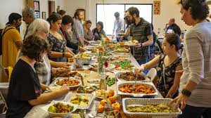
Marketing
Local Community
Near in location
Elevated Home style food
An equal chance for all to experience Tonga
PCC Tourists
Already at PCC; in their path
Already on an experience of culture
More suceptible to our product
Culture Tourists
Those who seek a new culture
Enthusiasts who want more than what is shown at PCC

Slide 6
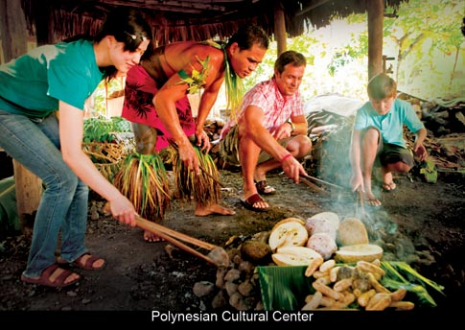
Guest Satisfaction
Friendly Services
Quick Services
Delicious Food
Wow experience
Comfortable Setting
Feedback Opportunity
Culture Experience
MALO 'AUPITO

Slide 7

Malo 'Aupito
Toe 'eva mai pe he kaha'u vave mai and thank you so much
Hope to see you again
206-555-0146
mirjam@contoso.com
www.atasteoftonga.com

